Slide 1
Slide 1
FAST AND INFORMATIVE MODEL SELECTION USING LEARNING CURVE CROSS-VALIDATION
DATA DRIVEN
Power Point Presentation
CS-363 Term Paper
Batch-No: 18
Y20CS154 – R INDEEVAR
Y20CS157 – RISHITHA G
L21CS198 – D YASWANTH
Guide : P. Rama Krishna Sir

Slide 2
ABSTRACT
Common cross-validation (CV) methods like k-fold cross-validation or Monte Carlo cross-validation estimate the predictive performance of a learner by repeatedly training it on a large portion of the given data and testing it on the remaining data . The drawbacks are that these techniques are slow on large dataset and they give almost no insights into the learning process of the validated algorithm.
So a new approach for validation based on learning curves (LCCV). Instead of creating train-test splits with a large portion of training data, LCCV iteratively increases the number of instances used for training. In the context of model selection, it discards models that are unlikely to become competitive. In a series of experiments on 75 datasets, we could show that LCCV leads to the same performance as using 5/10-fold CV while substantially reducing the runtime . Additionally, it provides important insights, which for example allows assessing the benefits of acquiring more data.

Slide 3
EXISTING TECHNIQUES
An important sub-task of model selection is to estimate the performance of each candidate model, which is done by so-called validation methods.
Some Of the Existing Techniques are:
Bootstrap
Common cross validation.
K-fold Cross Validation / Vanilla Cross Validation
Monte Carlo Cross Validation
Racing
Bayesian Optimization
Random Search
Wilcoxon Racing method
Successive Halving

Slide 4
Bootstrap
Bootstrapping is a resampling technique in machine learning to estimate the accuracy of the model.
It involves generating multiple samples of the original dataset by randomly sampling from the data set to generate new training and testing data with replacement.
Limitations:
Overfitting
Sensitive to Outliers
Computationally intensive
Limited applicability to certain models and datasets

Slide 5
Cross Validation
Cross-validation is a technique used to evaluate the performance of a model by splitting the available data into training and testing subsets. The goal is to estimate how well the model will perform on new, unseen data.
Some of the techniques are:
K-fold Cross Validation / Vanilla Cross Validation
Monte Carlo Cross Validation

Slide 6
Contd..
K-Fold Cross-Validation:
K-fold cross-validation is a technique used in machine learning to evaluate the performance of a model and estimate its generalization error. It involves splitting the dataset into K subsets, or folds, where K is typically set to 5 or 10.
2) Monte Carlo cross-validation:
Monte Carlo cross-validation is a technique used in machine learning to evaluate the performance of a model using random sampling. It involves randomly selecting a subset of the data for training and validation multiple times and averaging the results to estimate the model's generalization error.

Slide 7
Limitations Of CV:
Computational cost
Overfitting
Imbalanced Data
Bias

Slide 8
Racing Methods
Racing methods are the techniques that are used to compare and select among different machine learning models .
They work by running multiple models with different hyperparameter settings in parallel and iteratively eliminating the poorest performing models until the best one is selected.
Some of the common Racing methods for hyperparameter tuning :
Bayesian Optimization
Random Search

Slide 9
Contd..
Bayesian Optimization:
Bayesian Optimization is a method that uses a probabilistic model. The model is iteratively updated based on the performance of the models on the validation set, and the current model is used to select the next set of hyperparameters to be tested .
Random Search:
Random Search is a simple method that randomly selects a set of hyperparameters from a predefined range and evaluates their performance on the validation set.

Slide 10
Limitations Of Racing methods:
Computational cost
Overfitting
Sampling bias
It should be used in combination with other validation techniques to ensure the robustness and reliability of the final model.

Slide 11
Wilcoxon Racing method
In the Wilcoxon racing method, multiple algorithms or models are tested against each other using a series of pairwise comparisons.
For each pair of algorithms, Wilcoxon rank-sum test is performed and the one with higher rank is considered.
Limitations :
Require large number of pairwise comparisons
Assumes that the pairwise comparisons are independent

Slide 12
Successive Halving
Successive Halving in one type of validation method which uses principle of elimination. This algorithm is an iterative one which iteratively trains a set of models on fixed parameters and develop the fraction data and then selecting top performance models.
At each iteration, the fraction of data used to train the models is increased, and the number of models evaluated is reduced. This allows for more efficient use of computational resources, as the number of models evaluated decreases exponentially with each iteration.

Slide 13
Limitations of successive halving:
It depends on portfolio(Dependence on the fraction of data used for training).
Depends upon the choice of initial models, no of rounds and selection algorithm.
It’s a Greedy Approach.(Aggressive Pruning)

Slide 14
PROPOSED MODEL (LCCV)
Learning-curve-based cross-validation (LCCV) is a new approach for validation based on learning curves (LCCV). Instead of evaluating a candidate just for one training set size, it is evaluated, in increasing order, at different so-called anchors of training fold sizes, e.g. for 64, 128, 256, 512, ... instances. At each anchor, several evaluations are conducted until a stability criterion is met.
The LCCV idea is early recognize whether or not a candidate can be competitive. It makes the evaluation mechanism faster while at the same time not compromising the performance of algorithm selection procedure.

Slide 15
DETAILS OF PROPOSED MODEL
The main contribution of LCCV is that it combines empirical learning curves with an convexity assumption on learning curves to early prune candidates only if they are unlikely to be an optimal solution.
Empirical Learning: Empirical learning refers to the process of acquiring knowledge or skills through direct observation or experience.
Learning Curves:A learning curve is the representation in graph form of the rate of learning something over time or repeated experiences.

Slide 16
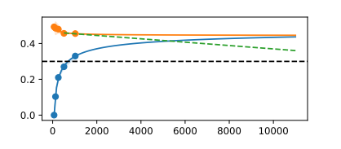
Example of Pruning LCCV
Here , the black dashed line represents threshold value r.
The X-axis indicates the set per anchor
The Y-axis indicates the Accuracy threshold value
The orange dots represent performance observations on the validation set per anchor.
The blue dots represent performance observations on the train set per anchor
The dashed green line represents the optimistic extrapolation from the last anchors on the validation curve.
If this optimistic extrapolation does not improve over threshold value r, it is unlikely that the learner will actually improve over this value, and the evaluation of the learner can be stopped early.

Slide 17
ADVANTAGES OF PROPOSED TECHNIQUE
It Works on any kind of datasets which are related to AutoML.
LCCV builds/evaluates multiple models at different anchors from scratch, usually in substantially less time.(Less Time Consuming)
Instead of a single-point observation, LCCV gives insights about the learning behaviour of a candidate. This is very useful to answer the question of whether more data would help to obtain better results.
The discarding decision in LCCV is model-free, which means that it does not rely on an imposed learning curve model like a power law.(No Bias)
Helps in identifying underfitting and overfitting: LC-CV can also help identify whether a model is underfitting or overfitting the data. If the accuracy of the model is low even when trained on a large training set, it is likely underfitting the data. On the other hand, if the accuracy of the model is high on the training set but low on the validation set, it is likely overfitting the data.

Slide 18
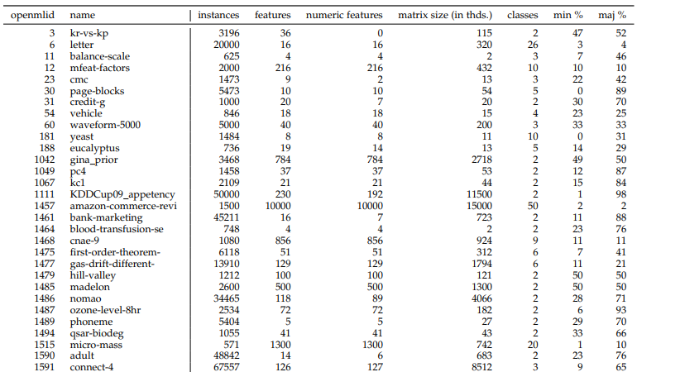
DATASETS

Slide 19
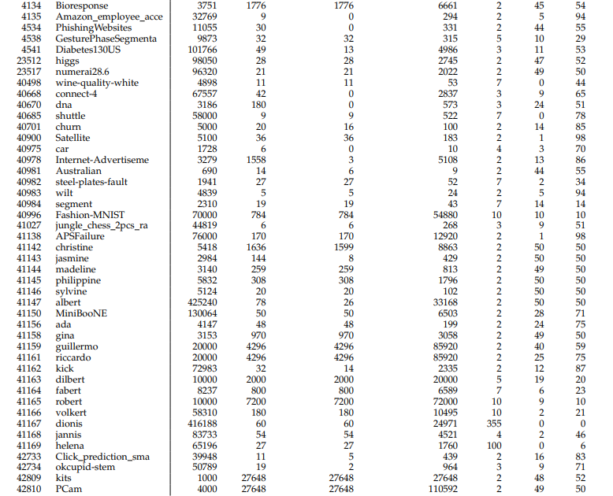

Slide 20
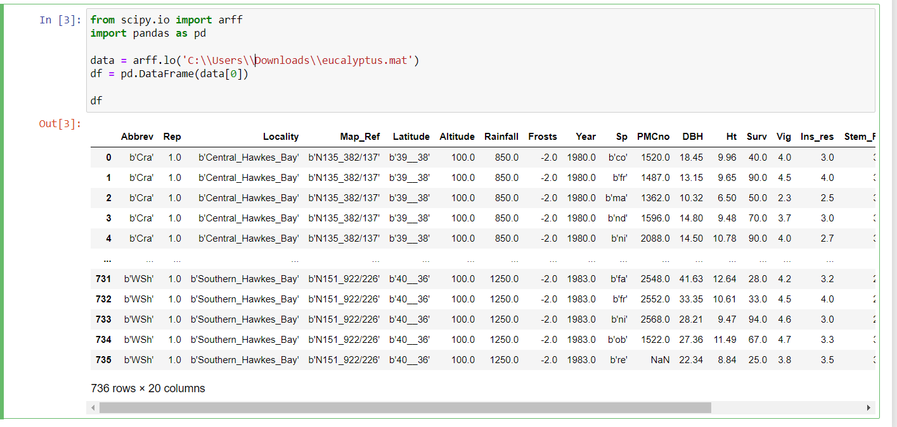
Sample Data Set

Slide 21
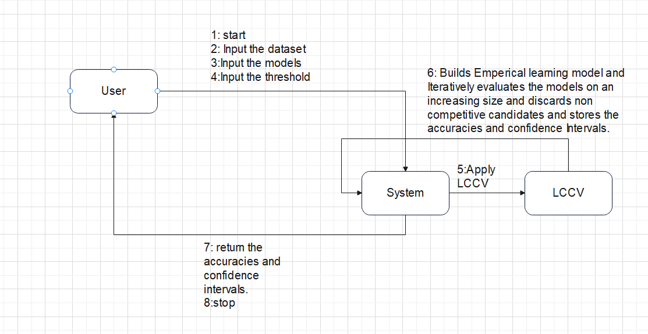
Workflow

Slide 22
Implementation Details
Learning curve based cross validation estimates the performance of the learner based on empirical learning curves.
LCCV evaluates the learner on ascendingly ordered so-called anchor(points) S=(s₁,…,s_{t}) which are training set sizes
The Idea is to early recognize whether or nor a candidate can be competitive.
The Algorithm is build by following points:
How we use the convexity of curve. And how we use a learning curve model.
How we make sure that this process only discards candidates that are sub-optimal with high probability.
How we use a learning curve model to skip anchors and directly jump to the final anchor s_{t} for competitive candidates.

Slide 23
Convexity
Convexity is important because it implies that the slope of the learning curve is an increasing function that, for increasing training data sizes, approximates 0 from below.
The idea of LCCV is that we can use learning curves to early recognize that a candidate will not be competitive.
For this,we can use both the train curves as well as the validation curves
Aborting based on validation curve:
We assume that the validation curves are convex.The convexity implies that we can take the observations of the last two anchors of our empirical learning curve,compute the slope and extrapolate the learning curve with this slope.From this we obtain a bound for the performance at the full data size and can prune if this bound will be worse than threshold value r.

Slide 24
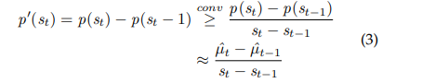
In mathematical terms,Denote the learning curve as a function p(s) where p is the true average performance of the learner when trained with train set of size s.Convexity of p implies that p’(s)<=p’(s’) if s’>s where p’ is the derivative of p.
Since learning curve is a sequence it is not differentiable so we rather sloppily refer to its slope p’ as the slope of the line that connects the point with its predecessor that is p’(s):=p(s)-p(s-1)
Given a sequence of anchors s₁,…,s_{t} in order to determine a learner can be pruned we can rely on the canonical estimate of p(s_{t}) which is the empirical mean u^_{t} of the observations at s_{t} we could rely on these estimates and use convexity to bound the slope with

Slide 25
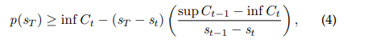
However, Replacing p’ in the above decision rule by this bound is admissible only if the estimates µˆt and µˆt−1 are accurate (enough). This calls for the usage of confidence intervals to obtain a notion of probabilities.
To compute such confidence bounds we follow the common assumption that observations at each anchor follow a normal distribution
Formally let C_{i} be the confidence intervals at anchor s_{i}.The best possible performance of this particular learner at the final anchor is

Slide 26
Aborting based on the Train Curve
We make the following assumptions which are common in machine learning literature
The error on the train performances typically mono-tonically increases as the number of observations increases.
The train performance at any anchor is typically better than the validation performance at any anchor.
The Consequence is that once the measured train error is already higher than the reference performance r it is is unlikely that this learner will improve over the r, we consider this criterion once the observations at each anchor are complete and consider the best training performance observed at each anchor.If this value is worse than r the candidate can be pruned.

Slide 27
How we make sure that this process discards candidates that are sub optimal with high probability
Given the approach based on confidence intervals atleast two observations are needed to obtain a standard deviation and hence to create a confidence interval.
The behaviour of LCCV can be controlled via four parameters
The number of samples per anchor is the factor that is under our control
Setting this value too low might result in inaccurate or large confidence intervals while setting this value to high unnecessarly slow down the validation process.
The minimum number of evaluations
The maximum number of evaluations
To enable a dynamic approach between two extremes we consider a stability criterion ε. As soon as the confidience interval width drops under ε we consider the observation set to be stable.

Slide 28
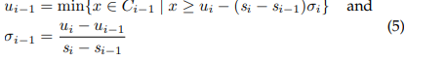
The stability criterion ε makes sense to adopt an additional sanity check that assures the observation set is convexity-compatible.
There is a easy-to-check necessary and sufficient condition of the convexity-compatible property.To this end, one tries to construct the curve backwards starting from last two anchors and to decrease the slope as little as possible from each anchor to the next one.
Let C₁, .., C_{t} be the confidence intervals at the t ascendingly ordered anchors
Let σ_{t} be the slopes between the anchors.
Let u_{t} be the minimal value that a convex-compatible curve can take at a given anchor t.
Now at each anchor i.,Starting with σ_{t} = 0, we can inductively define an observation set

Slide 29
If an observation set is not convexity compatible, we need to “repair” it before we can make decisions on pruning based on these results. Our repair technique is to simply step back one anchor. Stepping back from anchor s_{t} to s_{t−1},.
Two cases are possible now.
Either the convexity compatibility is already lost at anchor s_{t−1} in which case the same procedure is applied recursively stepping back to the anchor s_{t-2}.
Otherwise, it will return to anchor s_{t} and also re-sample a point at that anchor.
In many cases the convexity-compatibility will have recovered at this time.If not the procedure is repeated until the problem has been resolved or the maximum number of evaluations for the anchors has been reached

Slide 30
Skipping Intemediate Evaluations
Unless we insist on evaluating all anchors for obtaining insight into the learning process we should evaluate a learner in the full data once it becomes evident that it is competitive.
In order to skip the intermediate anchors we use a Morgan-Mercer-Flodin(MMF) model.The MMF model captures the learning curve as a function p^(s)=(ab+cs^{d})/(b+s^{d}) where a,b,c,d belongs to R₊.
Given atleast four anchors after sampling at an anchor has finished we can fit the parameters of the model and check whether p^(s_{t})<=r.In that case, we can immediately skip to the final anchor.

Slide 31
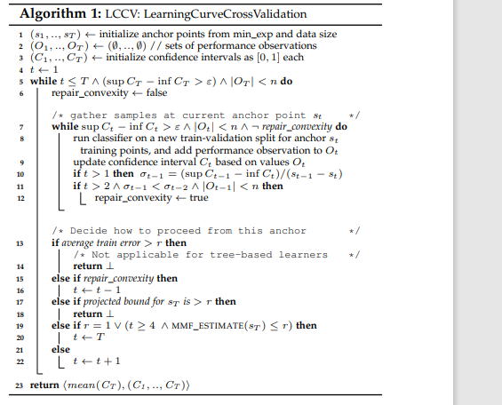
LCCV Algorithm

Slide 32
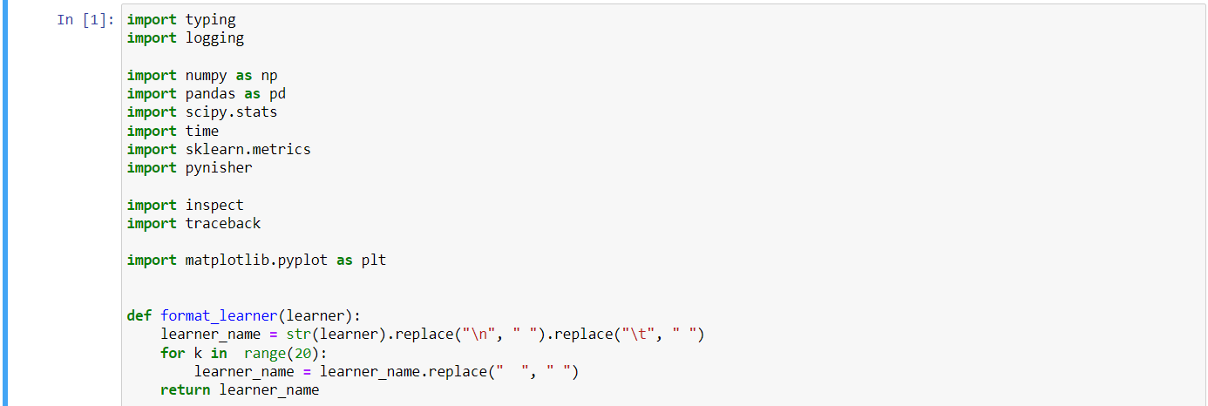

Slide 33
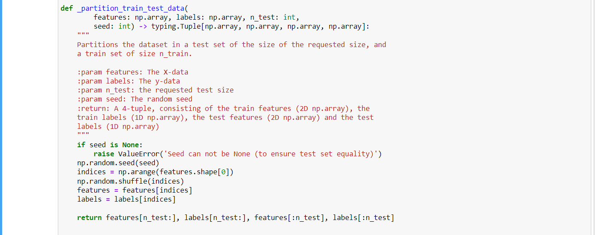

Slide 34
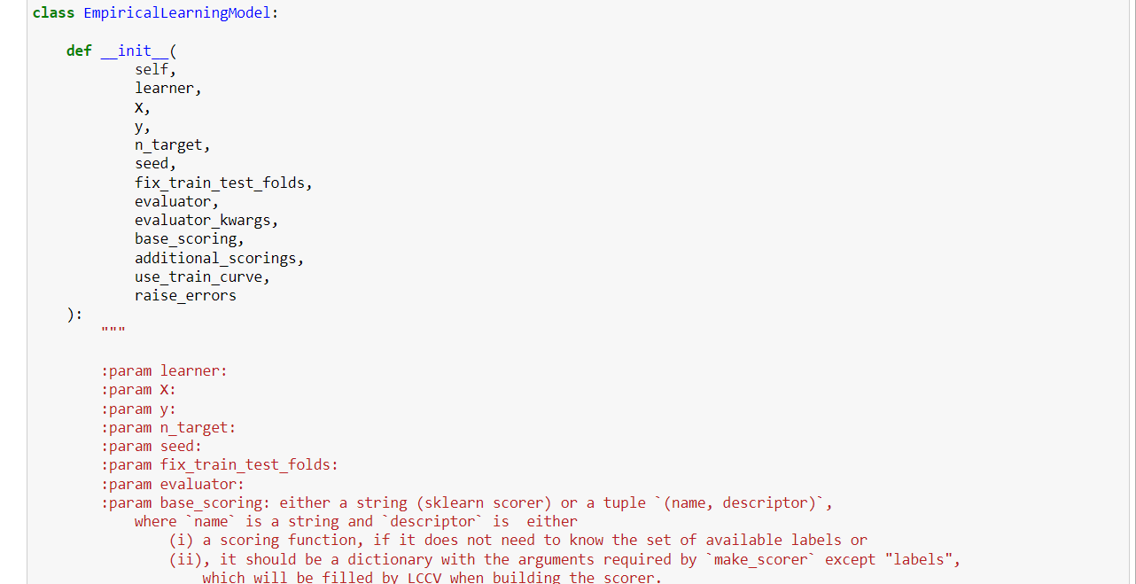

Slide 35
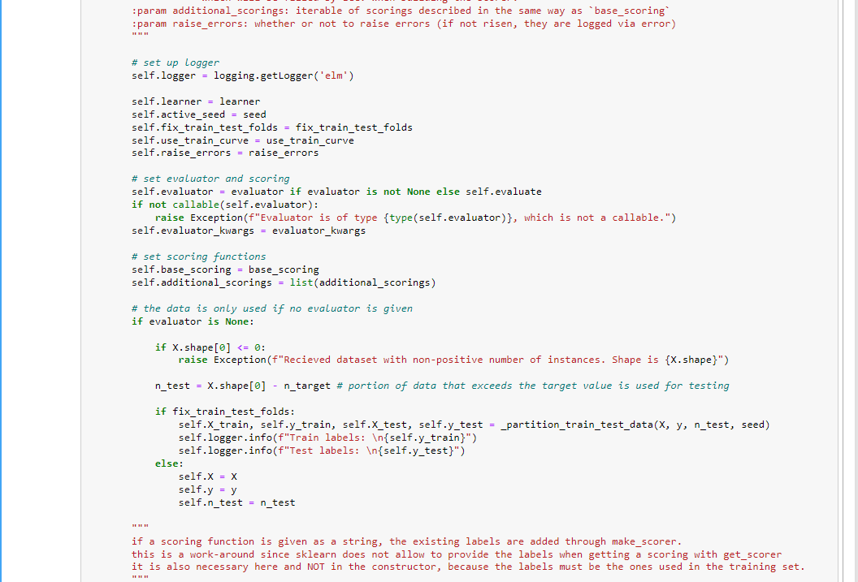

Slide 36
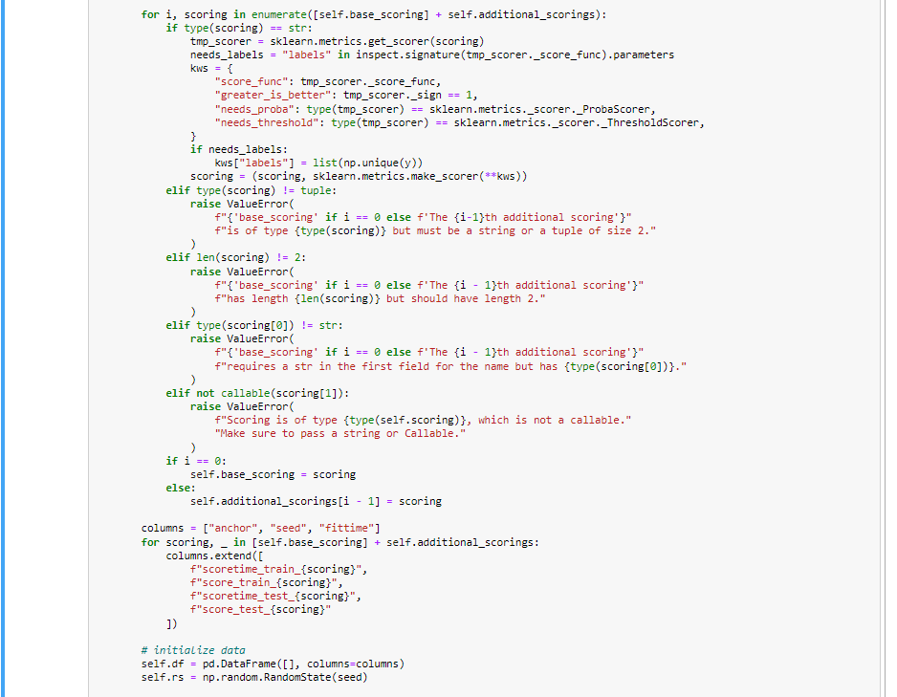

Slide 37
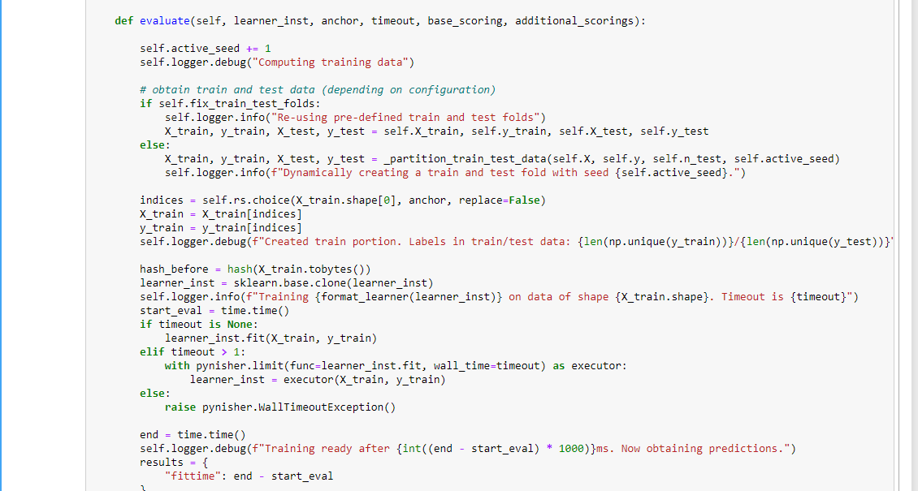

Slide 38
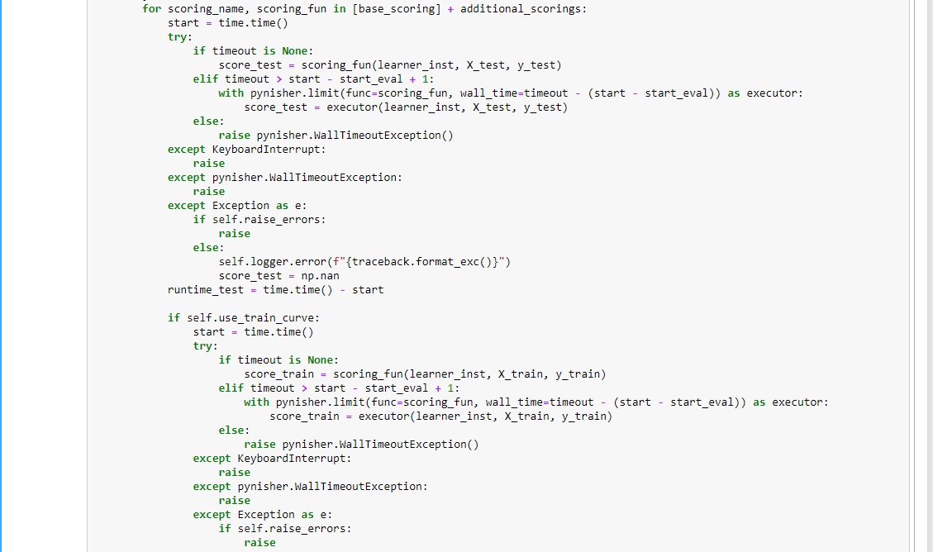

Slide 39
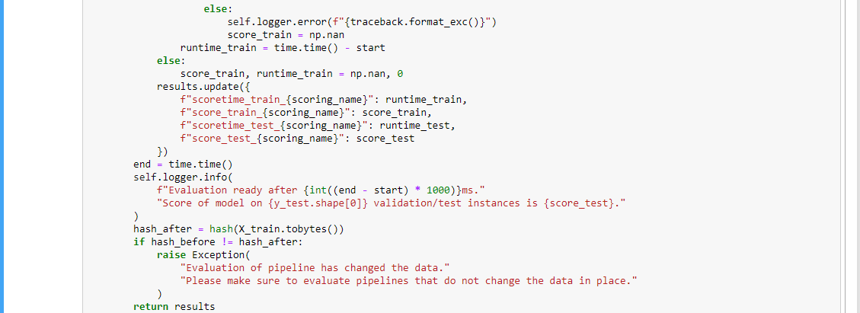

Slide 40
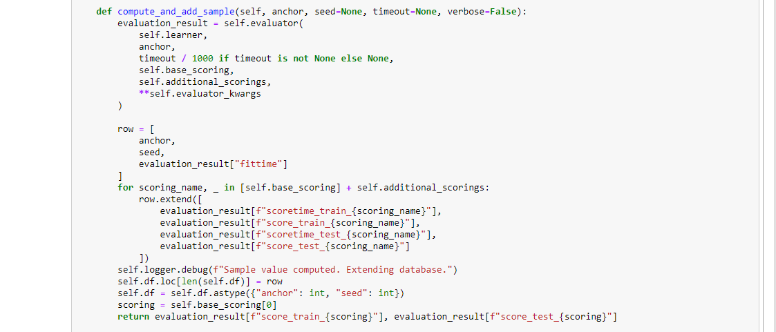

Slide 41
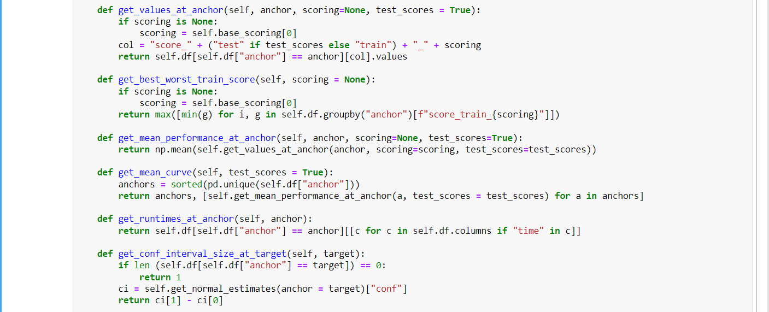
Utility Functions

Slide 42
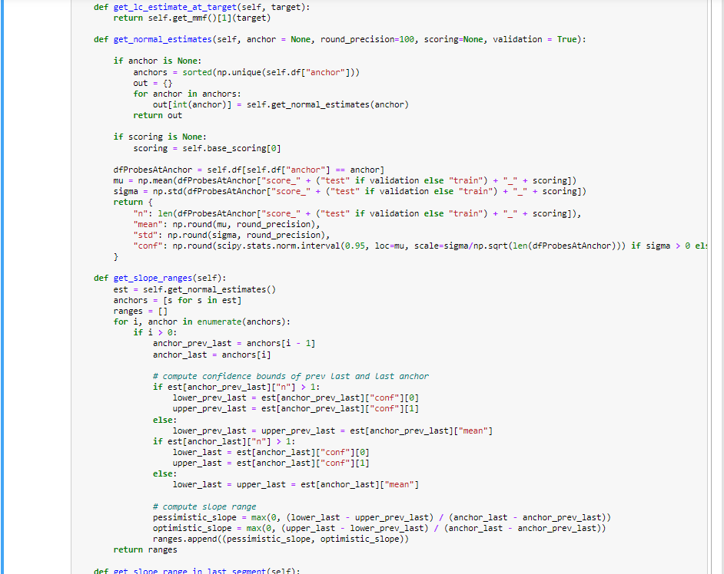

Slide 43
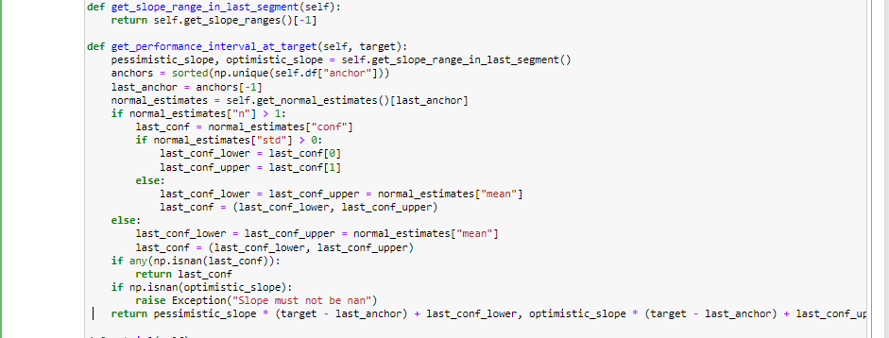

Slide 44
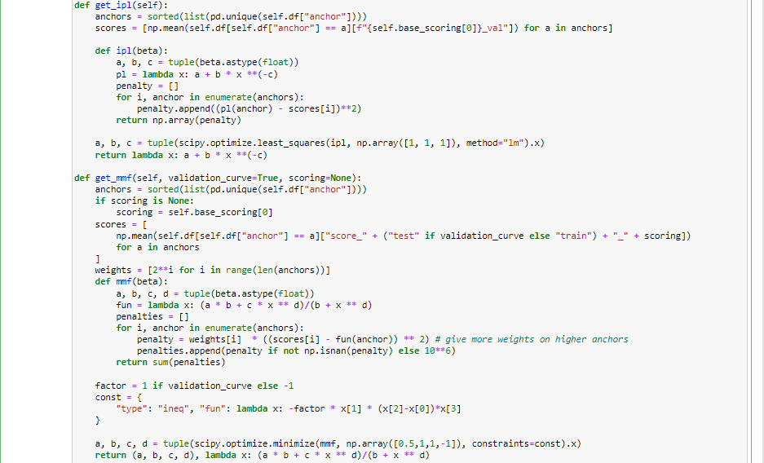

Slide 45
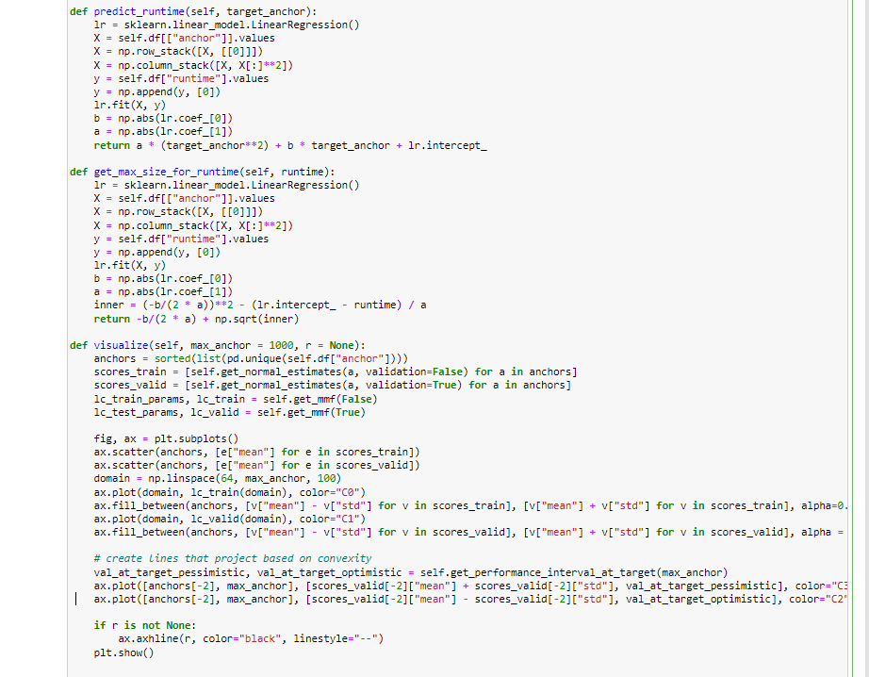

Slide 46
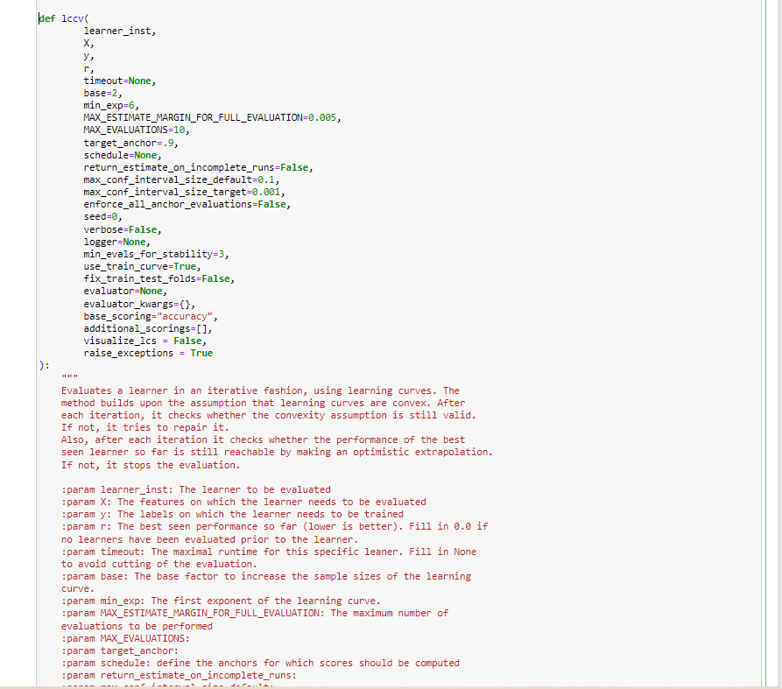

Slide 47
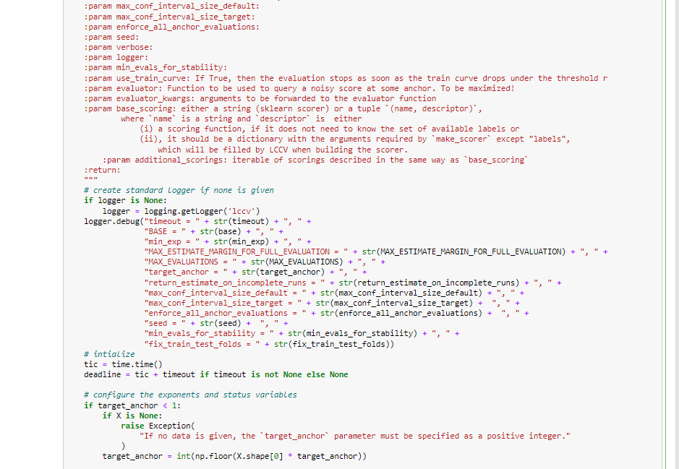

Slide 48
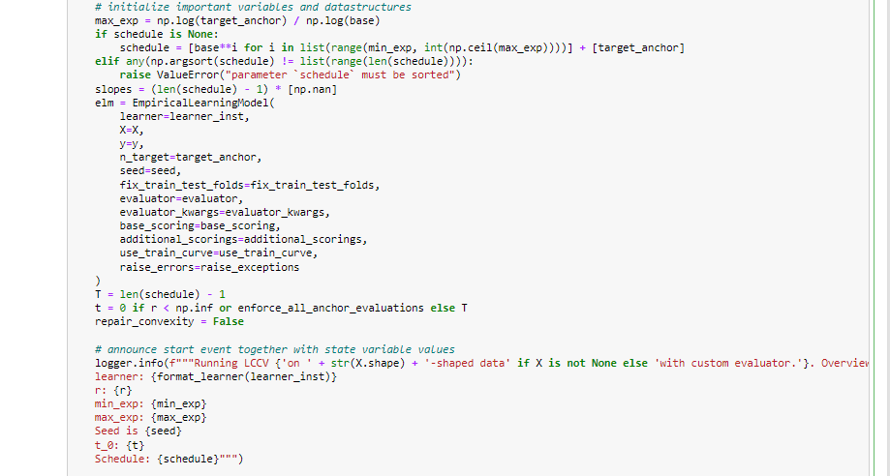

Slide 49
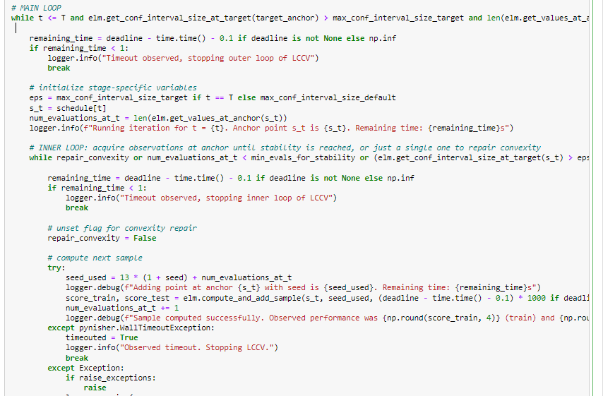

Slide 50
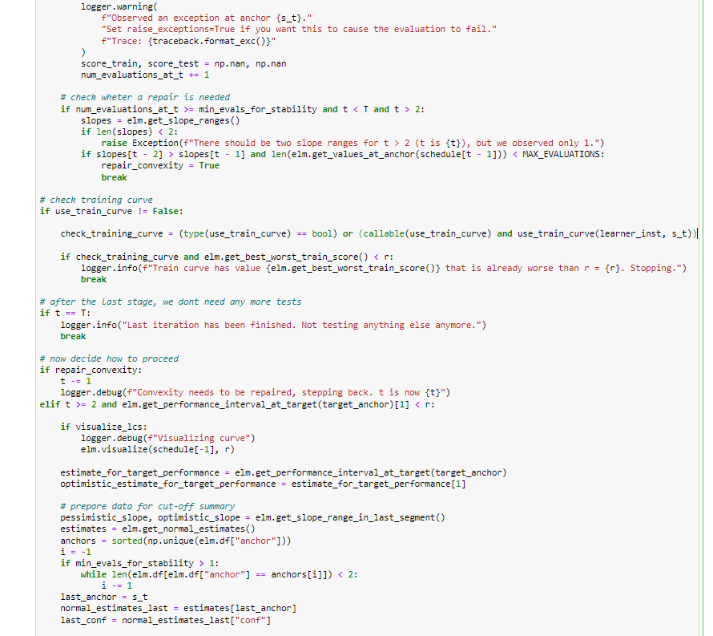

Slide 51
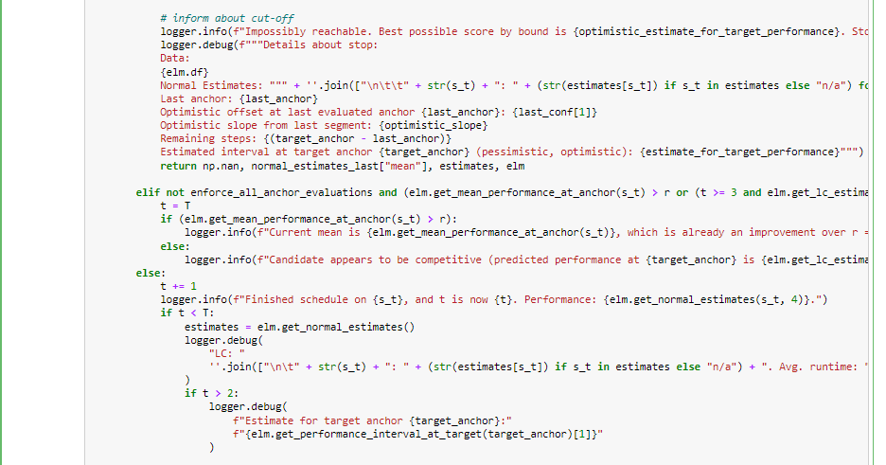

Slide 52
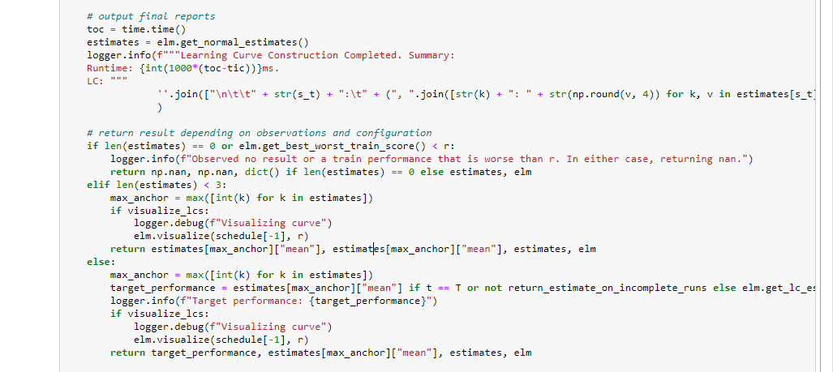

Slide 53
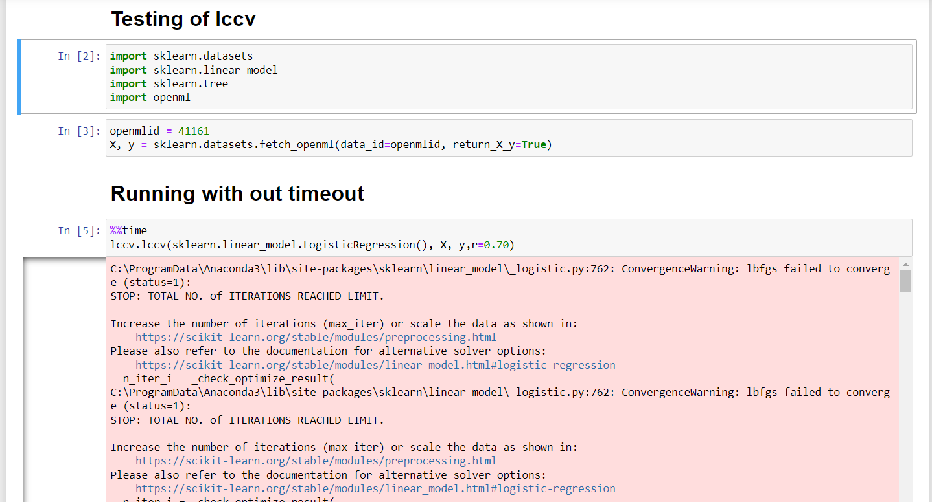

Slide 54
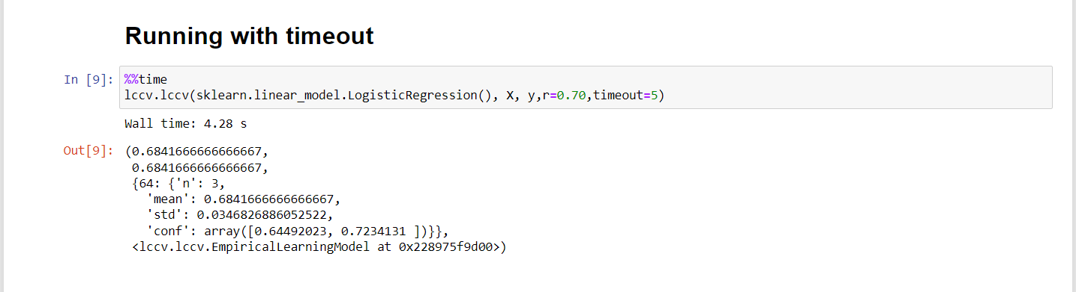

Slide 55
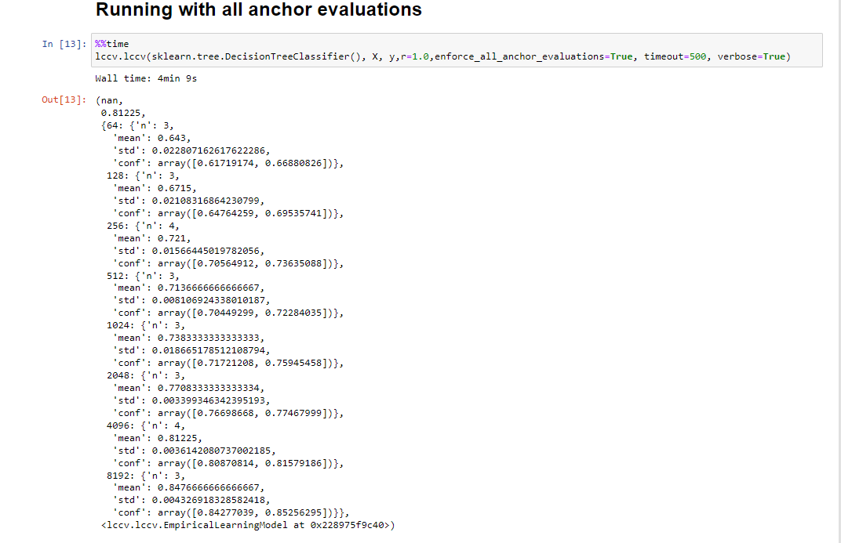

Slide 56
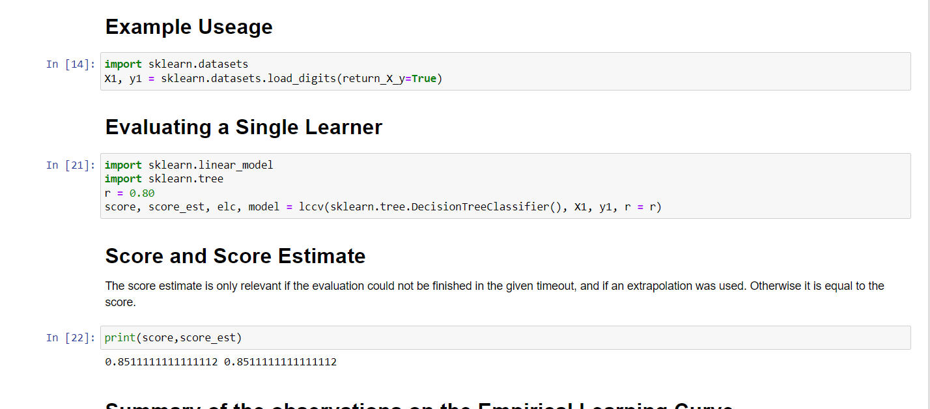

Slide 57
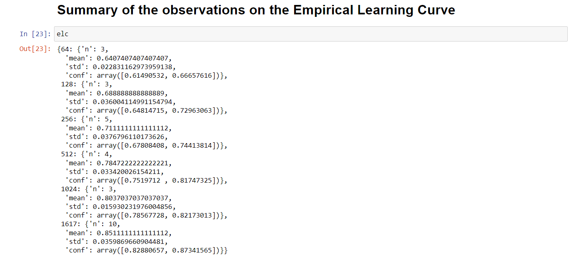

Slide 58
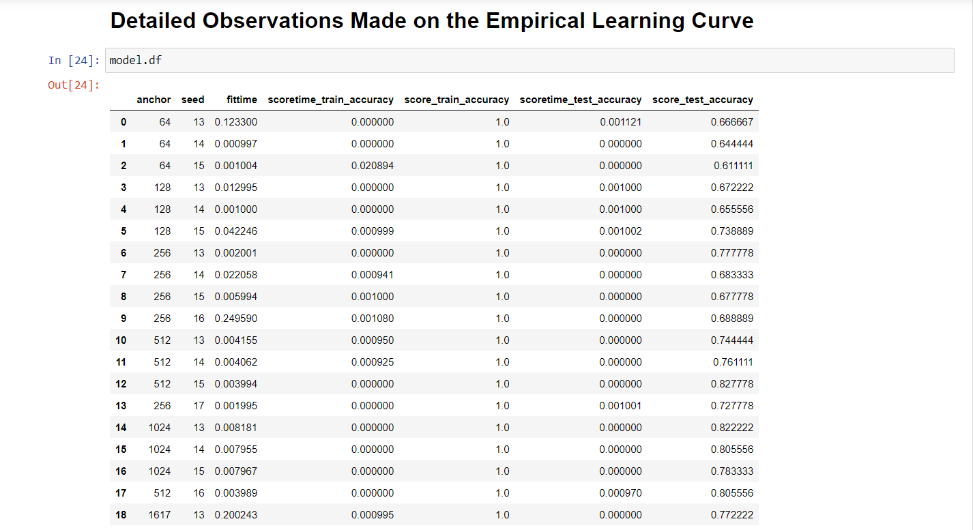

Slide 59
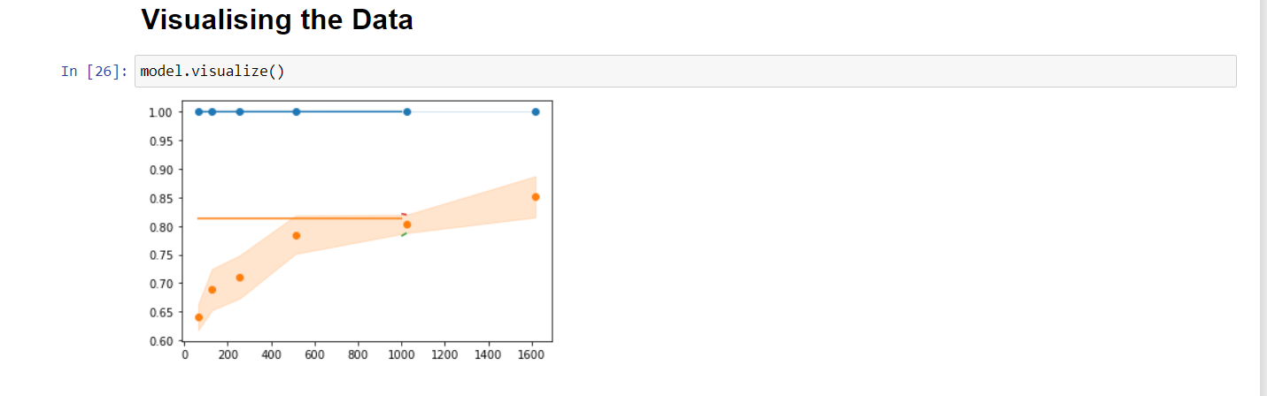

Slide 60
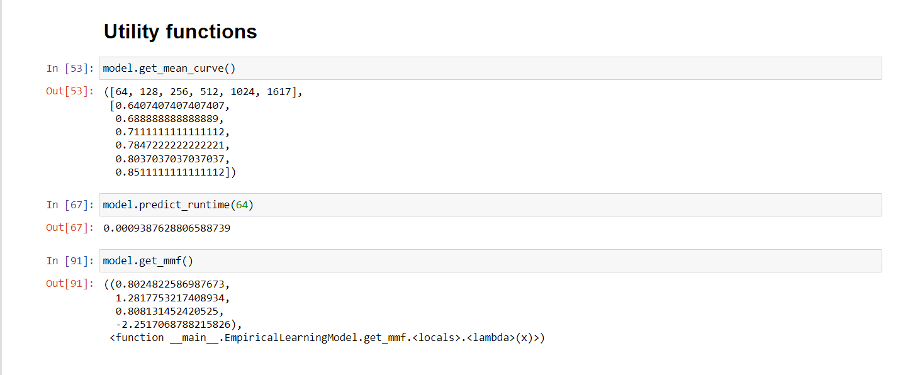

Slide 61
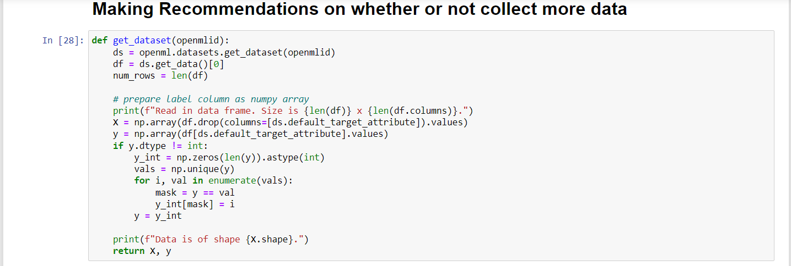
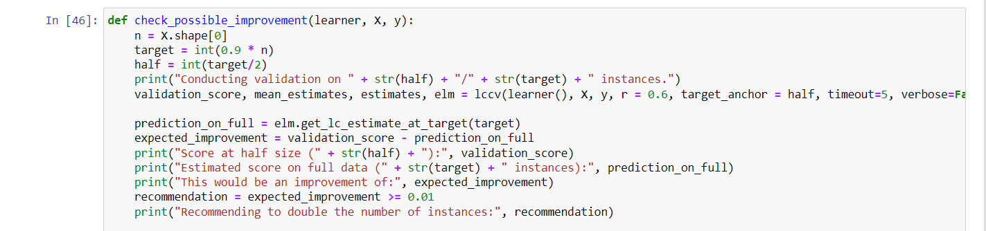

Slide 62
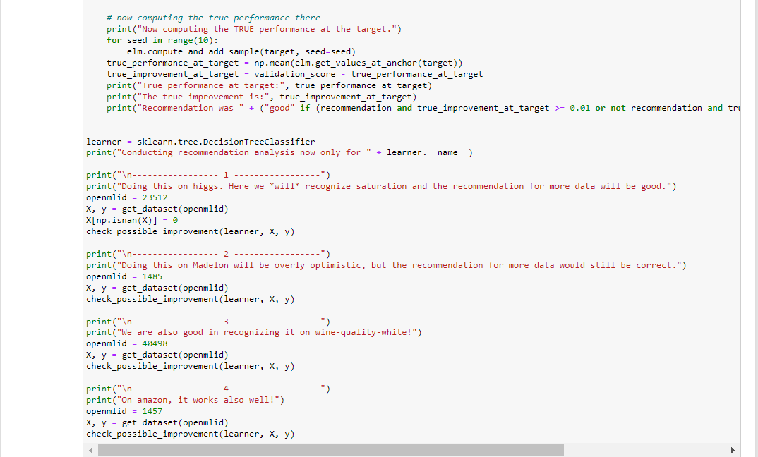

Slide 63
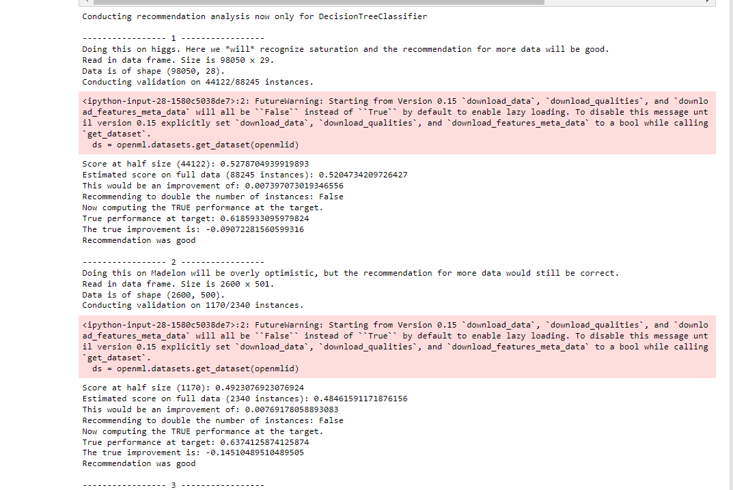

Slide 64
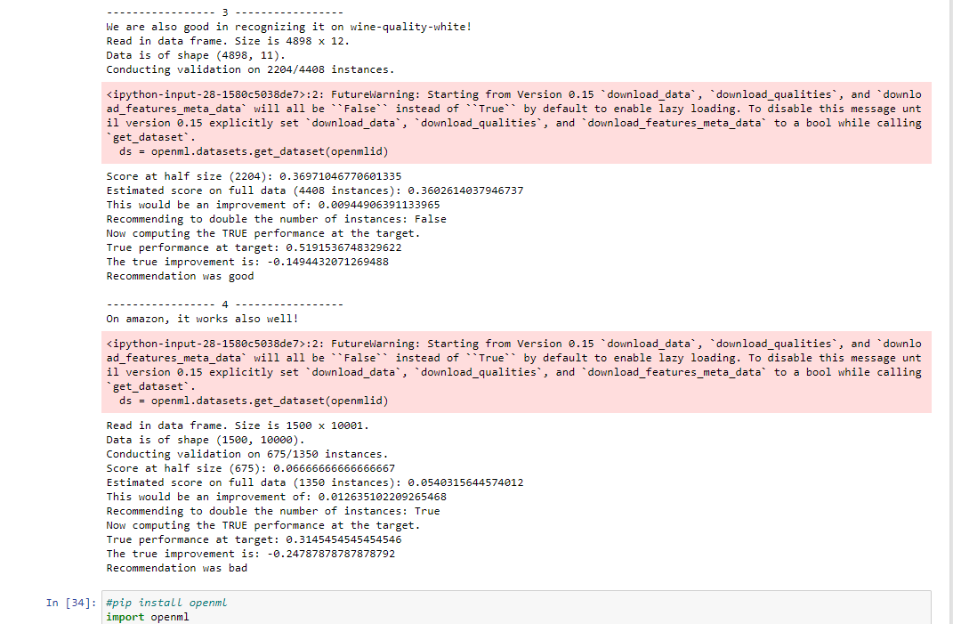

Slide 65
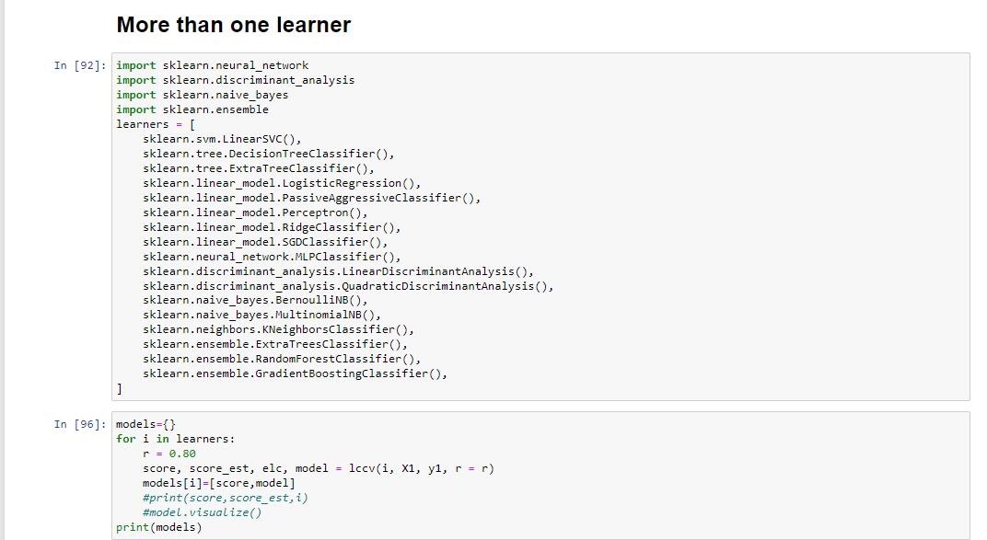

Slide 66
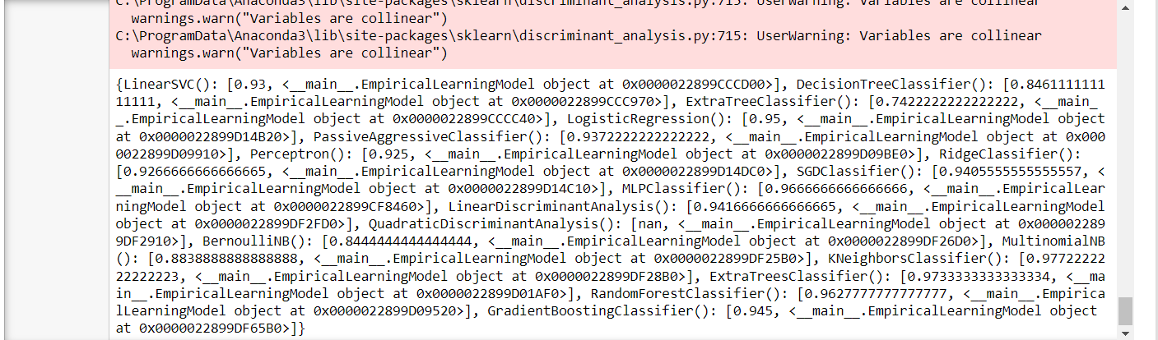
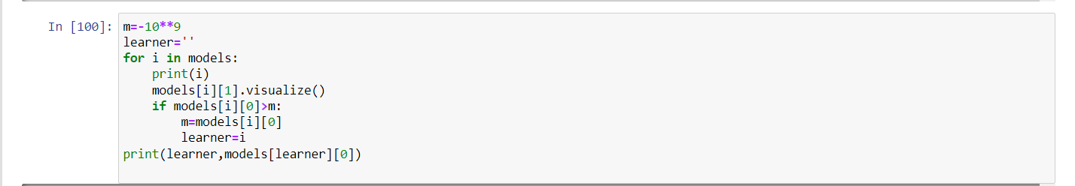

Slide 67
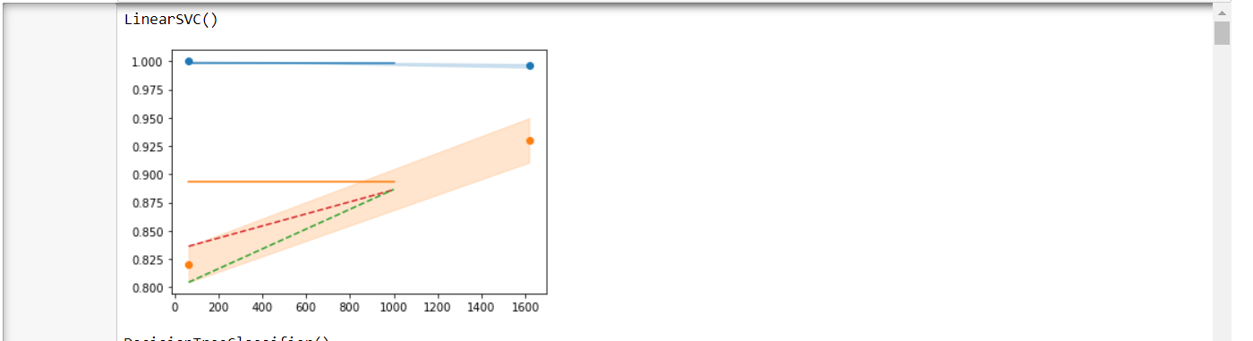
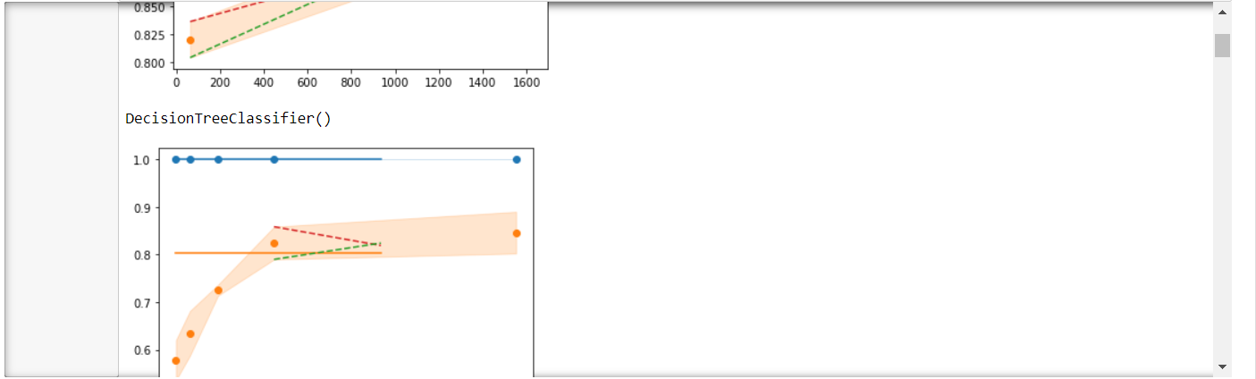

Slide 68
Result Analysis
We compare lccv with three sequential model validation techniques.
CV(Cross-Validation)
The first technique used is called CV (Cross-Validation), where the candidate assessment is performed using ν (either 80% or 90% of the available data for training).
Wilcoxon Signed Rank Test
The second technique, called Wilcoxon, is a racing-inspired variant of ν. Candidates are tested on various data samples and discarded as soon as it can be determined, based on a Wilcoxon signed rank test with a p-value of 0.05, that they do not outperform the current baseline.
Successive Halving
LCCV
The fourth technique is LCCV (Learning Curve Cross-Validation), denoted as 80-LCCV or 90-LCCV depending on the value of α.

Slide 69
By Running the above models on 13 datasets we considered the following factors for result evaluation.
Runtime Calculations.
Performance Gaps

Slide 70
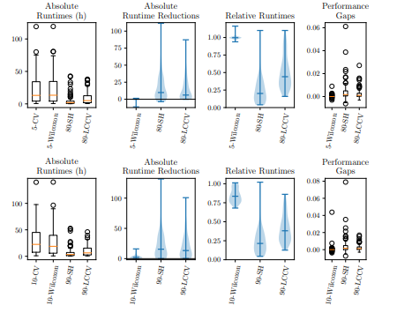
Result

Slide 71
Conclusion
In this paper, we presented LCCV, a technique to validate learning algorithms based on learning curves.
In contrast to other evaluation methods that leverage learning curves, LCCV is designed to avoid pruning candidates that can potentially still outperform the current best candidate.
Based on a convexity assumption, which turns out to hold almost always in practice, candidates are pruned once they are unlikely to improve upon the current best candidate

Slide 72

Slide 11
THANK YOU

